Slide 1
Can I do this forever?
Longevity, Purpose, and Sustainability in Surgical Technology Education
Kathy Patnaude CST, BS, FAST
Midlands Technical College
Columbia, South Carolina
February 7, 2026

Slide 2
Learning Objectives
By the end of this session, participants will be able to:
Differentiate between professional burnout and professional evolution within the context of surgical technology education.
Identify individual and systemic factors that influence long-term career sustainability among surgical technology educators.
Describe multiple professional pathways for growth, role redesign, and reinvention within surgical technology education.
Differentiate between professional burnout and professional evolution within the context of surgical technology education.
Identify individual and systemic factors that influence long-term career sustainability among surgical technology educators.
Describe multiple professional pathways for growth, role redesign, and reinvention within surgical technology education.
Assess their current level of professional sustainability using structured reflection tools.
Develop at least one actionable strategy to enhance career sustainability over the next 2–5 years.
Formulate a personal professional focus area (boundary setting, role redesign, growth, or support) to guide their next career phase.

Slide 3
Why do we choose this career?
Passion for teaching and mentoring
Desire to shape the next generation of surgical technologists
Opportunity to leave the physical demands of the OR
Stable schedule compared to hospital shifts (more flexibility)
No call, weekends or holidays☺
Professional respect, influence and a leadership role
Contribution to workforce development
Notes:
Continued professional growth, institutional support

Slide 4

Why this question matters
Notes:
The question is: “Can I do this forever”

Slide 5
Surgical technology education is rewarding—but demanding
Physical, emotional, and cognitive load is high
Many educators quietly wonder:
“How long can I keep this up?”
“Is it normal to feel so tired?”
“What’s next for me?”
“I feel overwhelmed”
Notes:
This session is about normalizing the questions and exploring answers.
This question does not mean you are weak. It means you are reflective.
Sow of hands, Who has asked themselves this at least once?

Slide 6
The Unique Demands of Our Role – The Reality of the Role
Teaching complex technical skills (psychomotor skills)
Managing professionalism and student behavior (unprofessional behavior)
Emotional labor with struggling students
Constant student needs (emotional support)
High Responsibility/Professional Pressure
Under-resourced programs
Rapid healthcare changes
Staying current with:
  Technology
  Accreditation standards
  Clinical expectations
  Often balancing teaching + clinical + administrative/service roles
Notes:
This is not a “light” profession.
Much of our hardest work doesn’t show up on a schedule. (Invisible work) – counseling students, mediating conflicts, writing documentation, remediation plans, employer communication, professional gatekeeping.

Slide 7
Signs People Begin Asking
“Can I Do this forever?”
Notes:
My presentation is to provoke thought, encourage networking

Slide 8
When the question starts showing up
Chronic fatigue or dread before class/clinical (Sunday night dread)
Irritability or emotional numbness (shortened patience)
Loss of passion or patience
Feeling stuck or trapped
Questioning competence or purpose
Physical strain from labs or clinicals (loss of joy)
Notes:
These are not failures. They are signals, not moral failures

Slide 9

Burnout vs. Evolution
Burnout
Evolution
Emotional Exhaustion
Cynicism/Detachment
Reduced effectiveness
Reduces sense of accomplishment
    Desire for new challenges/change
    Shifting life priorities
    Expanding identity
    Redefining impact
    Wanting broader impact
    Readiness for a new challenge
Notes:
Not everyone who questions longevity is burned out – some are ready to evolve.
Please remember there is an important distinction – Not everyone who wants change is burned out

Slide 10
Reflection –
Finish the sentences honestly:
The part of my job that drains me the most right now is ____.
The part that gives me the most meaning is ____.
Notes:
Are you tired of the profession or tired of how you are practicing it?
5 minutes small group discussion

Slide 11

What keeps us in this profession?
Student success stories/transformation
Shaping the future surgical workforce
Pride in the profession
Intellectual stimulation
Community and mentorship
Meaningful contribution to patient safety
Leading by example
Greater long-term sustainability
Reduced physical strain
Mastery
Notes:
(Resonate with the experiences, values, and emotions of those listening)
Reconnect with what brought you here
Invite people to call out their answers

Slide 12
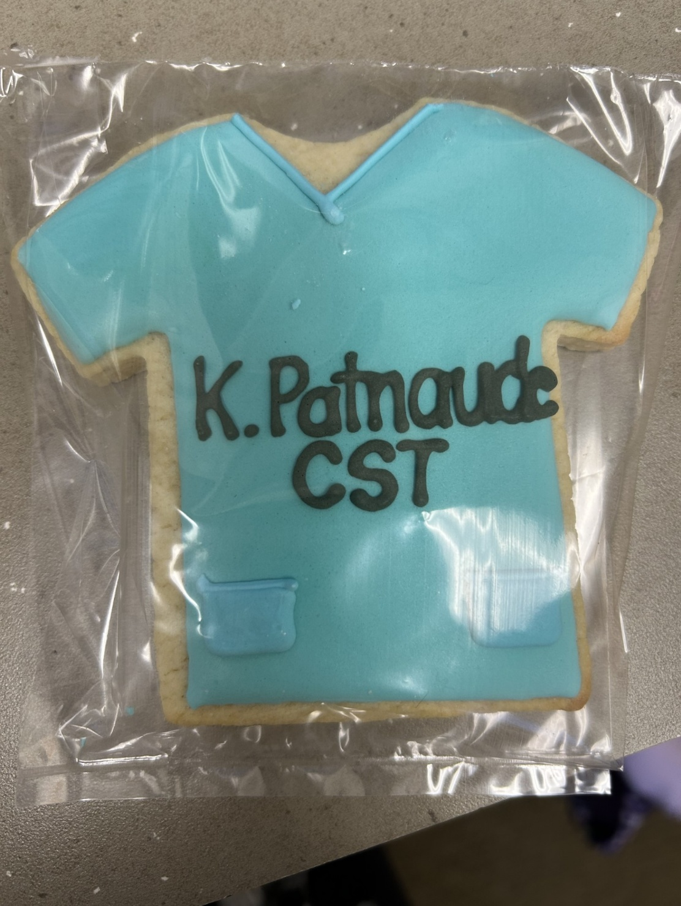
Just when you need it, a student gives you a cookie☺

Slide 13
What makes people leave?
Emotional exhaustion/overload
Lack of support or recognition/institutional barriers
Constant conflict or discipline issues (with no help from higher administration)
Workload creep/feeling overwhelmed
Limited growth pathways/lack of growth
Health and family priorities/health strain
Burnout and role/schedule overload
Accreditation and compliance stress/feeling undervalued
Student retention and engagement issues
Rapid changes in surgical technology
Furthering your education
Notes:
These are often systems issues – not personal weakness. Systems vs. self – Most educators don’t leave because they stop caring. They leave BECAUSE CARING COSTS TOO MUCH

Slide 14
The Myth of “Forever”
Few professionals do one role unchanged forever
Longevity often requires:
  Reinvention/role redesign
  Boundaries/boundary shifts
  New seasons/new challenges
The real question becomes:
  “How can I do this in a way that is sustainable for the long term?”

Slide 15
Redefining a Sustainable career
What Sustainability Actually Looks Like
Teaching fewer courses
Moving into curriculum, accreditation, or simulation
Mentoring faculty
Scholarship, publishing and research
Administrative or leadership roles
Returning part-time to clinical work
Consulting, speaking, writing
Hybrid or on-line course delivery
Program coordination
Continuing education presenter
Adjunct teaching
Notes:
You don’t have to leave the profession to change your role. Evolve inside it -

Slide 16
Personal Sustainability check-in
Ask yourself:
What drains me the most right now? (What is currently costing me the most energy)
What energizes me most?
What am I tolerating that needs to change?
What boundary would most improve my work life?
What would “better” actually look like?
Who supports me professionally?
What would make this job doable for the next 5 years?
Notes:
(Optional audience reflection activity)

Slide 17
The four pillars of longevity
1. Boundaries – workload, availability, emotional limits
2. support – mentors, colleagues, professional community
3. Growth – new roles, new skills, new projects
4. Meaning – reconnecting with impact and purpose
"You are an extremely valuable, worthwhile, significant person even though your present circumstances may have you feeling otherwise."
– James W. Newman
Notes:
reconnecting with impact and purpose - like you are this weekend. You are not alone, we all have concerns
Small groups: Share one thing you need more of. Share one thing you need less of, share one thing you could realistically make in the next year

Slide 18
Protective strategies for longevity
Strong professional boundaries
Peer support and mentorship
Periodic role refresh
Ongoing professional development
Saying NO without guilt
Physical and emotional self-care
Institutional advocacy
Notes:
In saying NO, I have always asked myself “what’s the worst that can happen? Become engaged with college committees, (faculty council, scholarship committee, leadership courses, etc.)
Professional development at the state level, Professional development outside the profession, like handing students, AI, etc.

Slide 19

Building a Long-game mindset
Think in seasons, not sentences.
Expect change.
Normalize career check-ins.
Allow ambition to shift.
Design your career – don’t just survive it.
Notes:
Have monthly meeting with your dean or department administrator. Be positive and come with a list.
Administration, VPs don’t understand? Take them to the OR
Sometimes you just “do it” and ask for forgiveness.

Slide 20
“Can I do this forever?”

Slide 21
If the answer to the question is “no”
No does not mean failure, It may mean:
  Not like this
  Not at this pace
  Not in this role
  Not in this environment
  Skills as surgical educators transfer powerfully into:
  Healthcare leadership
  Education administration
  Simulation
  Quality and safety
  Corporate training/Workforce development
  Consulting/Educational expertise
  Clinical authority
Notes:
There is life after – and within – this profession.
Nothing you have built is wasted. No one can take it from you.

Slide 22
If the answer is yes, but…
“Yes, but with changes” is often the healthiest answer
Identify:
  One boundary
  One growth goal
  One support connection
  One thing to let go of or release

Slide 23
Closing reflection
“Can I do this forever?”
Becomes:
How can I design a career that honors both my students and myself?
“The goal is not endurance.
The goal is sustainability.”

Slide 24
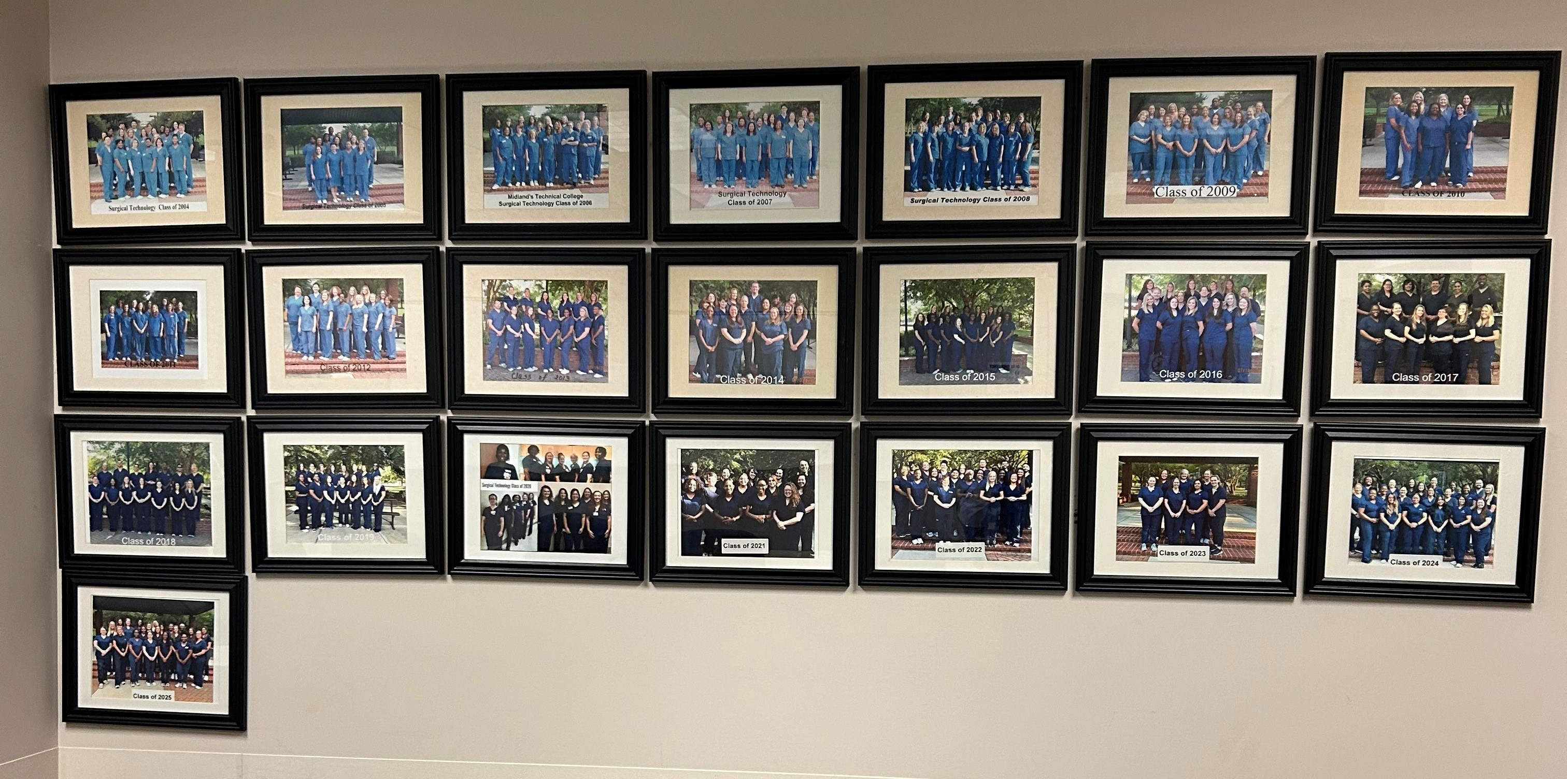

Slide 25
Thank you patnaudek@midlandstech.edu
What season are you in?
What would make this work
sustainable for you?
This Photo by Unknown Author is licensed under CC BY-SA

